Slide 1
It’s Hot out
Tabletop Exercise

Slide 2
Agenda
Welcome
Introductions
Facilitated discussion
Hot Wash

Slide 3
Exercises Benefits:
Increase readiness in the event of an actual emergency
Provide a means to assess effectiveness of response plans and response capabilities
Serve as a training tool for response personnel and their involvement with other response agencies
Provide an opportunity to practice skills and improve individual performance in a non-threatening environment

Slide 4
Exercises Benefits: (cont.)
Network in order to pre-plan decisions regarding resources
Identify planning conflicts or gaps
Identify resource needs and opportunities for sharing of resources
Clarify internal and external roles and responsibilities

Slide 5
Exercise Objectives:
By the end of the scenario,
participants should have identified ICS Staff, Sections, Branches, Division or Groups needed for the scenario and positions needed for the event.
participants should be able to identify equipment needed for rehabilitation.
participants should be familiar with rehabilitation operations.
participants should have knowledge of rehabilitation in different weather conditions.

Slide 6
Roles and Responsibilities:
Participants respond to the situation presented based on knowledge of response procedures
Facilitator provides situation background and moderates discussions

Slide 7
Exercise Rules of Engagement:
There is no single solution
Varying viewpoints, even disagreements are expected
Dialogue encouraged within a safe, open, stress-free environment
Respond based on your knowledge
Your organization’s positions or policies do not limit you
Make your best decision based on the circumstances presented

Slide 8
Rules of Engagement (cont.):
Basis for discussion consists of scenario narratives, your experience, and your understanding.
All information required to drive discussion during tabletop is contained in exercise material
Treat every scenario as if it might affect your area – don’t “fight” the scenario

Slide 9
LODD
On December 3, 2011, a 45-year-old male volunteer fire fighter (“the FF”) was dispatched to a structure fire. Wearing turnout gear and self-contained breathing apparatus (SCBA) off-air, the FF assisted in exterior fire suppression operations followed by interior overhaul (SCBA on-air) for a total of 30 minutes. After 10 minutes of self-rehabilitation, the FF assisted in breaking down hose lines when he commented that he “felt funny.” He walked to the rescue unit and suddenly collapsed (0541 hours). Crew members notified dispatch to request an ambulance while cardiopulmonary resuscitation (CPR) was begun, and an automated external defibrillator (AED) was placed; three shocks were administered. Advanced life support was provided by the ambulance personnel at the scene and during transport to the local hospital emergency department (ED). Inside the ED, the FF’s pulse returned, but he never regained consciousness. An acute heart attack was diagnosed, and emergency cardiac catheterization was performed with stent placement. The FF, however, suffered recurring bouts of ventricular fibrillation in the catheterization lab and in the intensive care unit over a period of 4 hours. At 1120 hours the FF was declared dead and resuscitation efforts were discontinued.
The death certificate and the autopsy report listed “myocardial infarction” as the cause of death. Given the FF’s underlying coronary artery disease (CAD), NIOSH investigators concluded that the physical stress of fire suppression activities triggered his heart attack which resulted in sudden cardiac death.

Slide 10
Module 1: Structure Fire
May 6, 2021

Slide 11
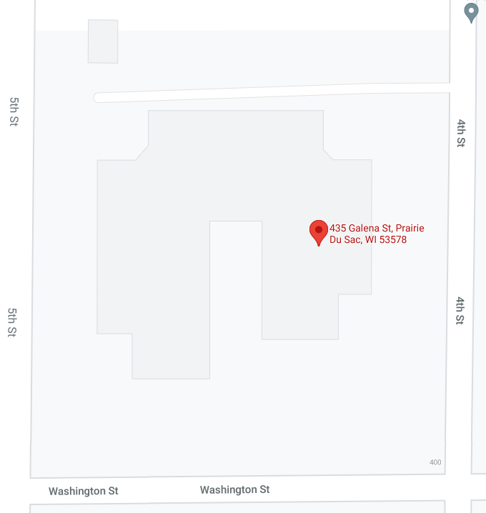
1900
Today’s temperature is 90 degrees with 90 % humidity. No rain is forecasted.
Prairie du Sac FD, Sauk City FD, and Sauk Prairie Ambulance are dispatched to 435 Galena St for a working structure fire.
Dispatch is advising they are getting reports of occupants trapped.

Slide 12
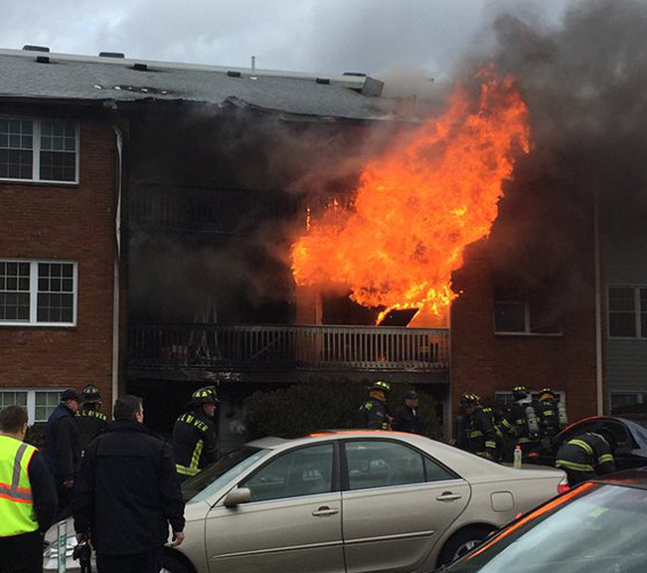
1904
Police arrive at the scene and report there are flames showing and there are several people saying there are people still trapped inside.

Slide 13
1908
PDS Fire Chief arrives at the scene and reports that the A side has flames showing from two apartments. There are no exposures on the 360. There is also light smoke coming from the D side but no flame showing.

Slide 14
Questions
The following slide has questions for Fire and EMS. Work together for 5-10 minutes and come up with answers. We will regroup and discuss what each group needs and how we manage this scene together.

Slide 15
Questions:
Who is in Command and what does the Org Chart look like including any Staff, Sections, Branches, Divisions or Groups?
What additional resources do you need? How are those requested?
Who is doing accountability?
Who is doing scene safety?
What are the incident objectives?

Slide 16
Group discussion
What did each group come up with and how do we bring all the needs together to work together at the scene for the common good.
What are the incident priorities?

Slide 17
1910
The command structure has been established, including accountability, safety, objectives, and resource ordering procedures.

Slide 18
1930
Fire has been able to extricate all known victims during an offensive attack and search and rescue. A secondary search is ongoing with fresh search teams.

Slide 19
Questions
What concerns do you have for the crews that were on the initial fire attack and primary search?
What concerns do you have about other firefighters, EMS, and law enforcement at the scene?
What equipment needs to be set up for Rehabilitation?
Who has this equipment?
Who will oversee rehabilitation?
How would rain or a thunderstorm change your location for rehab?

Slide 20
Group Discussion
What did each group come up with and how do we bring all the needs together to work together at the scene for the common good.

Slide 21
1940
Rehabilitation has been set up and some firefighters are moving in that direction.

Slide 22
Questions
When should someone go to rehabilitation?
Who is going to make sure that everyone who is supposed to be going to rehab is going?
What if someone from your department refuses to go?
What if someone from a mutual aid department refuses to go?
What if the rehab group supervisor / team leader is reporting a firefighter does not fit the criteria to return to the fireground?
What if that firefighter is demanding to return, saying they are fine?
When should others not directly involved in fire operations (pump operators, chiefs, EMS, PD) go to rehab?

Slide 23
Group Discussion
What did each group come up with and how do we bring all the needs together to work together at the scene for the common good.

Slide 24
What if?
What changes with this scenario if it is 20 below zero with a 30 mile per hour wind?

Slide 25
Group Discussion
What did each group come up with and how do we bring all the needs together to work together at the scene for the common good.

Slide 26
Hot wash
One person speak at a time.
Be professional, this is not “to blame”
Comment on subjects within the structure of the scenario.
What went well?
What can we improve on?
Recommendations for corrective action?

Slide 27
Conclusion
Evaluation – Please fill out the form in detail and be honest.
Thank you!

